Slide 1
Exterior Ventricular Drain (EVD)
Group Members: John Ostrander, John Brinkman, Brian Schutter

Slide 2
Hydrocephalus, excess CSF in circulation, characterizes a neurological emergency
Humphrey, E. (2018). Caring for neurosurgical patients with external ventricular drains. Nursing Times, 114(4), 52-56.
Notes:
Anatomy, CSF, subarachnoid space, ventricles,, increase pressure, headache, vomiting, developmental issues, mild dimentia

Slide 3
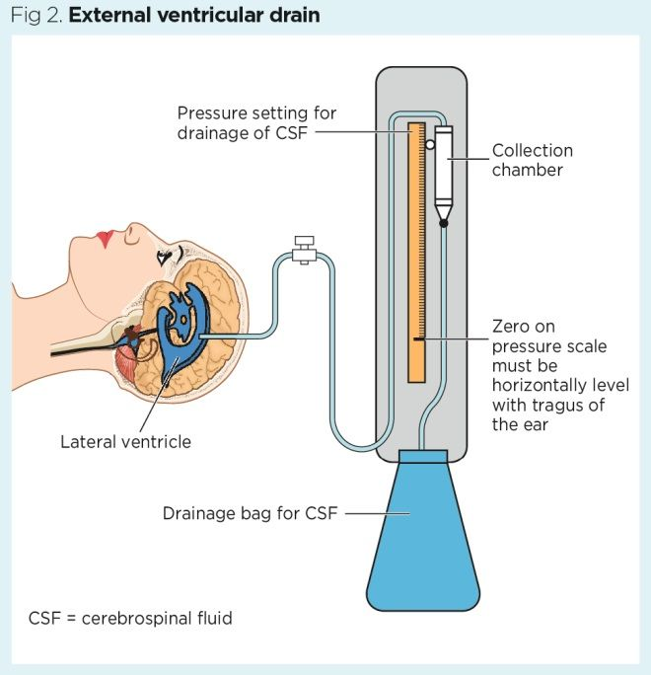
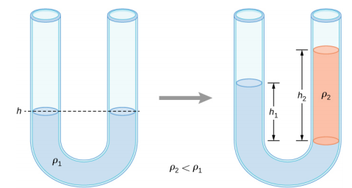
Exterior Ventricular Drain (EVD) relieves pressure in the brain
Humphrey, E. (2018). Caring for neurosurgical patients with external ventricular drains. Nursing Times, 114(4), 52-56.
https://phys.libretexts.org/Bookshelves/University_Physics/Book%3A_University_Physics_(OpenStax)/Map%3A_University_Physics_I_-_Mechanics%2C_Sound%2C_Oscillations%2C_and_Waves_(OpenStax)/14%3A_Fluid_Mechanics/14.2%3A_Measuring_Pressure
Notes:
Skull, hemisphere, drain bag, physics, manual, ICU, Tragus = fiducial

Slide 4
Population and Market
40,000 EVD Procedures
$19,824.68/day in ICU
Length of stay = 5 Days
$3.96 billion annually
Young, S., Ross, P., & Beltramo, F. (2019). 369: Epidemiology And Outcomes Of External Ventricular Drains In The Pediatric Icu. Critical Care Medicine, 47(1), 166.
Chu, J. K., Feroze, A. H., Collins, K., McGrath, L. B., Young, C. C., Williams, J. R., & Browd, S. R. (2019). Variation in hospital charges in patients with external ventricular drains: comparison between the intensive care and surgical floor settings. Journal of Neurosurgery: Pediatrics, 1(aop), 1-6.
https://www.hydroassoc.org/about-us/newsroom/facts-and-stats-2/
Notes:
EVD, $, days, off intensive care, without surgery

Slide 5
Need Statement
External Ventricular Drain (EVD) is an extremely common neurosurgical procedure that relies on draining excess cranial cerebrospinal fluid (CSF) in hydrocephalus patients in which the current monitoring and flow rate control methods are time-consuming and inadequate for patient safety, opening the door for a novel drainage system that reduces clinical monitoring, increases patient safety, and improves quality of life.
Notes:
EVD Bevan, common procedure, ICU cost, set and forget, patient safety

Slide 6
Drainage Tracking Systems
Ultrasound
Weight Scale
Optical Measurement
U.S. Pat. No. 4,448,205
Imprecise
Interference w/ other US devices
U.S. Pat. No. 5,769,087
Sensitive to motion
Requires estimation to keep pressure constant
U.S. Patent No. 9,074,920
Measures to a final volume or time
Cannot account for intracranial pressure
Mendels, Y., Revzin, I., Manny-Aframian, V., & Rubinstein, E. G. (2015). U.S. Patent No. 9,074,920. Washington, DC: U.S. Patent and Trademark Office.
Notes:
Measuring techniques, Ultrasound-imprecise, weight-sensitive to motion, optical measurement – accurate but as with all, does not control pressure

Slide 7
Flow control systems
Resistance Control
Issues
Not automated
Requires trial and error
Does not update to changing flow rates
Stebbins, K., & Pennell, I. T. J. (2017). U.S. Patent No. 9,656,006. Washington, DC: U.S. Patent and Trademark Office.
Notes:
Interesting, uses resistance changes, manual, flow rate is estimated 17 mL/hour

Slide 8
Design Requirements
Specification | Metric | Value
Intracranial Pressure | Pressure | .93 – 2.00 kPa
Size | Weight | < 5 Kg
 | Volume | < 50 cm³
Catheter | Diameter | 3-5 mm
 | Length | 2 m
 | Material | Biocompatible
 | Surgical Insertion Time | < 30 minutes
 | Compatibility Time | > 1 week
User interface | Flow rate display | LED screen
 | Alert for dangerous measurements | Loud alert and/or mobile notification
Fluid Data Acquisition | Flow rate | 100 mHz sampling rate
 | Ion concentrations in CSF | 100 mHz sampling rate
Drainage Control | Flow rate control | 0.2-0.4 mL/min
 | External pressure control | 1.33 - 4.00 kPa
Patient Monitoring | General Movement | 10 mHz sampling rate
 | Head movement and position | 10 mHz sampling rate
Intracranial Pressure | Pressure | .93 – 2.00 kPa
User Interface | Alert for dangerous measurement | Loud alert and/or mobile notification
Patient Monitoring | Head movement and position | 10mHz sampling rate
Notes:
Pressure scale determines kind of equipment, tailoring to each patient
User interface allows patients off ICU, connect to hospital system,
Movement stops flow for safety

Slide 9
Notes:
Pressure control, algorithms, this semester have concept and 3D printed parts

Slide 10
Team Responsibilities
Mechanical Design
Software Development
Clinical Integration
CAD modeling, Prototyping
Coding, Deadline Management
Client interface, Supply Management

Slide 11
Thank you.
Questions?

