Slide 1
External Ventricular Drain (EVD)
Group 17
John Brinkman, John Ostrander, Brian Schutter
Notes:
Recap – Hydrocephalus – too much intracranialpressure (ICP) so need to drain cerebrospinal fluid from the brain

Slide 2
Specification Update
Specification | Metric | Value
Catheter | Material | Biocompatible, non-allergenic
Fluid Data Acquisition | Flow rate | 100.0 Hz sampling rate
 | Ion concentrations in CSF | 100.0 Hz sampling rate
Drainage Control | Flow rate control | 0.30-0.35 mL/min
 | External pressure control | 2.50 - 3.00 kPa
Patient Monitoring | General Movement | 10.0 Hz sampling rate
 | Head movement and position | 10.0 Hz sampling rate
Cost | Dollars | Sum<$200
Notes:
Basically kept everything the same except narrowed the value windows, fixed the sampling rate to accommodate pulsing, and added cost specification. Didn’t change anything else

Slide 3
Overview of Project
2 basic problems to solve
Measuring Intracranial Pressure (ICP)
Controlling ICP / drainage flow
Separated designs into these 2 components
Try to find best combination
Combine with microcontroller (Arduino)
(Except one design that does both)
Note:
CSF: Cerebrospinal fluid
ICP: Intracranial pressure
Notes:
Use Arduino to connect the 2

Slide 4
Measurement Designs
Arduino Pressure Sensor
PSI Gauge Pressure Sensor
Flow Rate Pressure Monitor
Blood Pressure Catheter
CSF collection calculation
Simultaneous Pressure Controller and Sensor

Slide 5
Arduino Pressure Sensor
Pros:
Cheap
Designed for Arduino
In series with catheter
Cons
High flow range: (1 – 60 L/min) vs .2 mL/min CSF flow
Low accuracy
Notes:
Small wheel inside with magnet attached - Measure flow then calculate pressure

Slide 6
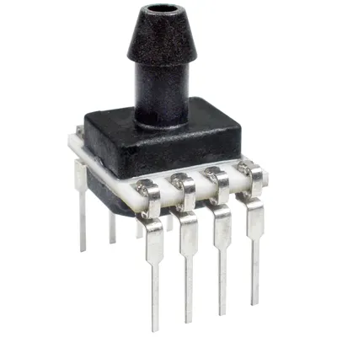
PSI Gauge Pressure Sensor
Pros
Arduino compatible
Accurate
Correct range
Cons
Unclear data format
Minimum Quantity is 50
Expensive
Notes:
Parallel Connection with drainage – static measurement
Piezoelectric technology to measure pressure - accurate
Piezoelectric Effect is the ability of certain materials to generate an electric charge in response to applied mechanical stress – Directly connects to bread board

Slide 7
Flow Rate Pressure Monitor
Pros
Can be connected in series with flow
Measures flow pressure
Cons
Requires PowerMAT data processor
Measure high flows and pressures
Notes:
Similar to Arduino flow sensor, but more sophisticated
powerMAT increases cost

Slide 8
Blood Pressure Catheter
Pros
Adapting already widely used device
Accurate
Correct range (~2 kPa)
Cons
Doesn’t connect to Arduino directly
Costly
Notes:
Sensing catheter inserted into guide catheter – Another concern - When using for blood pressure, not also draining it

Slide 9
CSF Collection Calculation
Pros
Simple Design and calculation
Easy to integrate into current system & to Arduino
Cheap
Cons
Inaccurate
Measures flow and pressure indirectly
Notes:
Place force sensor between bag and stand, measure weight difference over time and convert that to flow rate

Slide 10
Simultaneous Pressure Controller and Sensor
Pros
Pressure is sensed and controlled simultaneously
Cons
Not directly compatible with Arduino
Expensive
Used for industry
Not catheter compatible
Designed for higher flows
Notes:
Diaphragm type piezoresistive sensor ----

Slide 11
Sensors Pugh Chart
 | Weight | Design # 1: Arduino Pressure Sensor | Design # 2: PSI Gauge | Design # 3: Flow Pressure Sensor | Design # 4: Blood Pressure Catheter | Design # 5: CSF Collection Calculation | Design # 6: Simultaneous Pressure Sensor/Controller
Weight | 5 | 7 | 4 | 7 | 8 | 5 | 7
Volume | 3 | 3 | 8 | 8 | 9 | 7 | 5
Catheter Diameter | 6 | 6 | 7 | 8 | 10 | 10 | 5
Catheter Length | 4 | 5 | 5 | 6 | 10 | 10 | 3
Material | 3 | 6 | 6 | 8 | 10 | 10 | 4
Compatibility Time | 3 | 8 | 8 | 8 | 9 | 10 | 5
Portability | 2 | 8 | 8 | 6 | 9 | 9 | 8
Interface (data output) | 8 | 10 | 7 | 8 | 7 | 8 | 10
Fluid Data Acquisition | 10 | 6 | 7 | 7 | 9 | 2 | 10
Ion Concentration Measurement (Y/N) | 1 | 0 | 0 | 0 | 0 | 0 | 0
Pressure Measurement Error | 7 | 5 | 8 | 6 | 8 | 5 | 8
Cost (higher=cheaper) | 7 | 8 | 5 | 6 | 3 | 9 | 2
Operational Pressure/Flow Range | 10 | 3 | 8 | 3 | 8 | 2 | 7
Power Requirement | 6 | 4 | 6 | 8 | 5 | 8 | 4
Score |  | 443 | 497 | 487 | 575 | 474 | 479

Slide 12
Final Sensing Decision
Blood pressure Catheter
Chosen for
Best accuracy and measurement range
Handles pulsing
Next step
Connect with Arduino
Ensure draining and sensing can work simultaneously

Slide 13
Controlling Designs
Simultaneous pressure controller and sensor
Current Method – manual drainage bag height adjustment
I/Q valve flow rate controller
Automated drainage bag height adjuster

Slide 14
Manual drainage bag height adjustment
Pros
Currently used
Relatively reliable
Cons
Requires constant care in the ICU
Patients cannot move
negligible improvement to current system
Notes:
Flow rate and pressure determined by height of bag
Height determined by neurosurgeon
Only change compared to before would be an alert for dangerous flow/pressure

Slide 15
I/Q valve flow rate controller
Pros
In series
Relatively simple
Cons
Intended for industry use – adapter necessary
Accuracy decreases with smaller flow
Notes:
Electrical signal modulates flow through apparatus – just opens / closes orifice

Slide 16
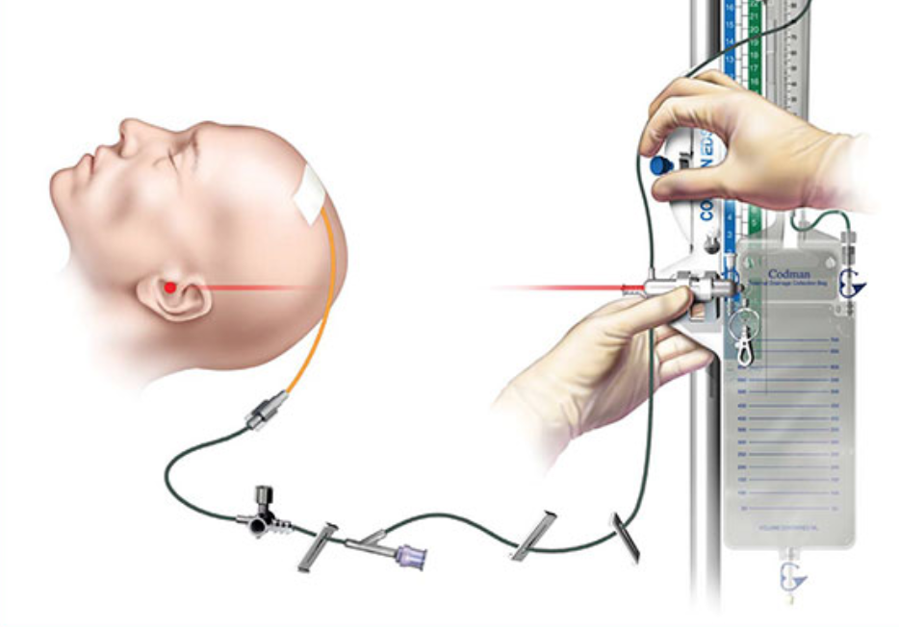
Automated Drainage Bag Height Adjuster
Pros
Simple
Cheap
Basic principles already in use
Automated
Cons
Slow response time
Adds some bulk
Notes:
Arduino motor + pulley system to control height
Add shut off valve to bag or catheter for motor movements and emergency situations to increase patient safety

Slide 17
Controllers Pugh Chart
 | Weight | Design # 6: Simultaneous Pressure Sensor/Controller | Design # 7: Leave it Manual | Design # 8 : I/Q Valve | Design # 9: Automated Drainage Bag Height Adjuster
Weight | 5 | 10 | 10 | 9 | 10
Volume | 3 | 10 | 10 | 7 | 10
Catheter Diameter | 6 | 10 | 10 | 10 | 10
Catheter Length | 3 | 10 | 10 | 10 | 10
Material | 3 | 10 | 10 | 10 | 10
Compatibility Time | 2 | 7 | 8 | 8 | 8
Portability | 1 | 8 | 7 | 6 | 6
Cost | 7 | 3 | 10 | 4 | 7
reaction time | 8 | 8 | 2 | 8 | 6
Pressure / flow Control Error | 8 | 8 | 2 | 8 | 6
Operational Pressure / flow Range | 8 | 8 | 6 | 2 | 8
Automation | 10 | 10 | 1 | 10 | 9
Safety | 10 | 6 | 3 | 6 | 9
Power Requirement | 3 | 8 | 10 | 8 | 8
Score |  | 619 | 443 | 564 | 635

Slide 18
Final Controlling Decision
Automated Drainage Bag Height Adjuster
Chosen for:
Simplicity / cost
Arduino compatibility
Based on current method but adds automation
Next steps →
Design pulley/motor system
Consider effects of bag movement on flow

Slide 19
Thank you. Questions?

