Slide 1
Automated External Ventricular Drain: Verification & Validation
Group 17: Brian Schutter, John Ostrander, John Brinkman

Slide 2
Outline
Project Changes
Verification Plan
Validation Plan
FDA Process
Proof-of-Concept

Slide 3
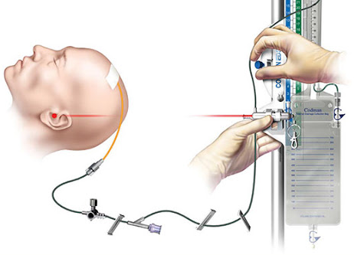
Chosen Solution: automated external ventricular drainage
Osborn, B. (2014)

Slide 4
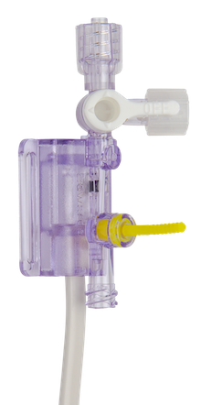
Design Specification Changes
Flow Rate
60/min
ICP
1/min
Fluid Acquisition:
Sampling Rate:
Edwards (2020)

Slide 5
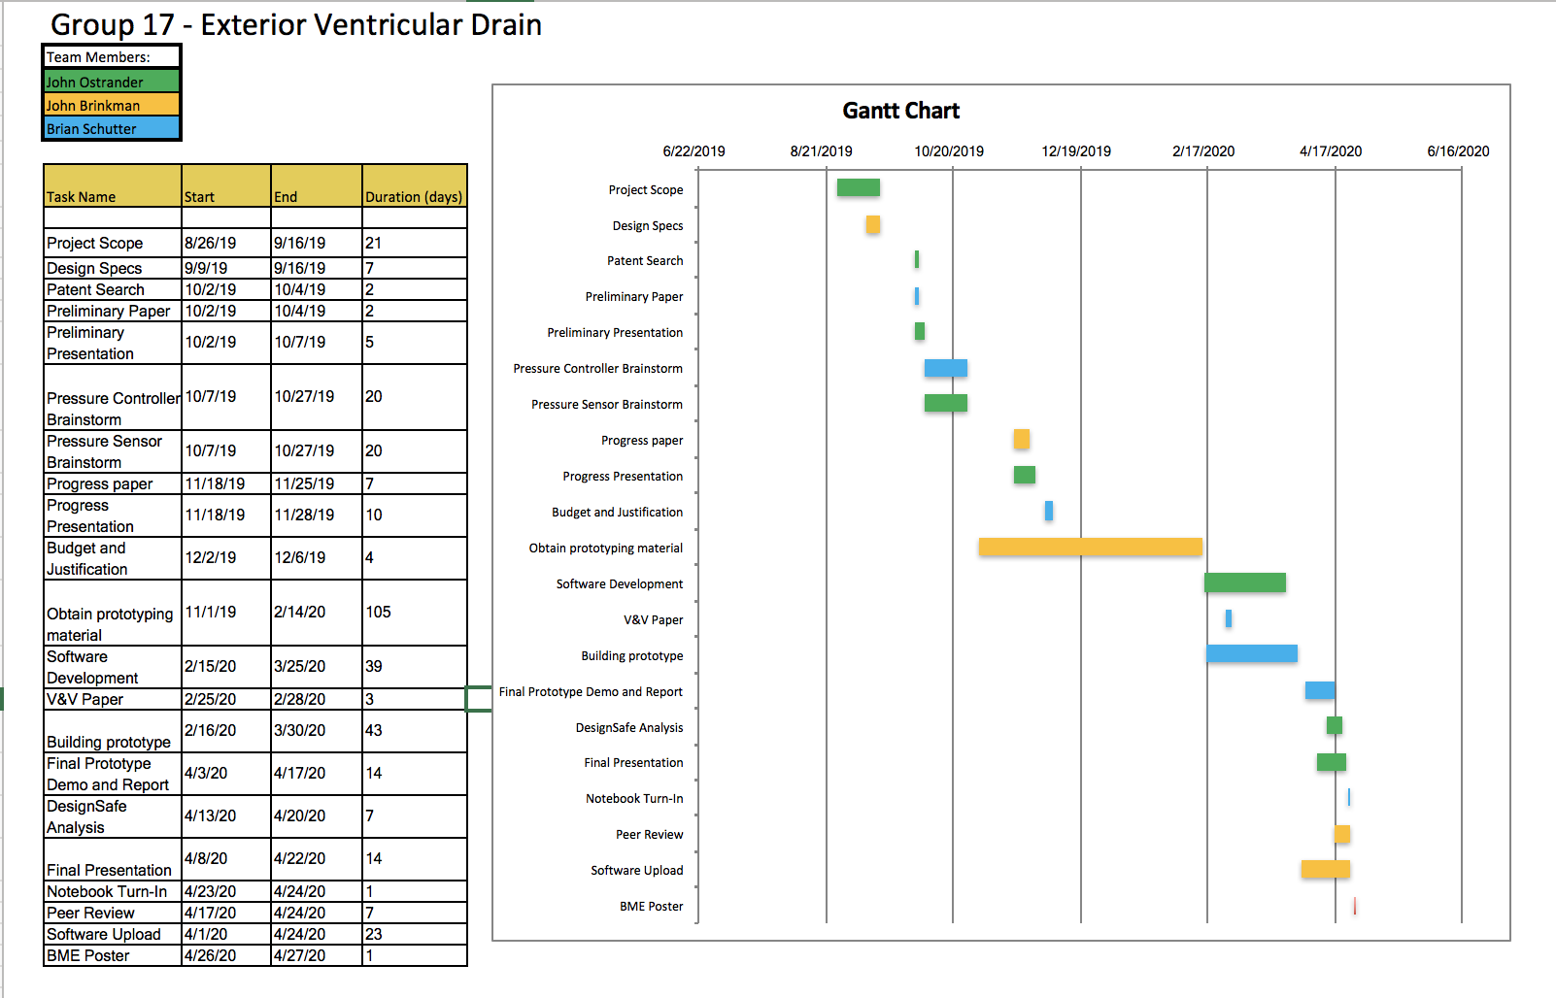
The schedule was updated to dedicate more time to software and prototype development

Slide 6
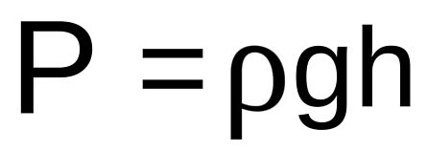
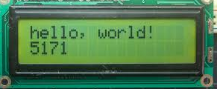
Verification Plan
Pressure Sensing
Compare pressure outputs to manually calculated values
Drainage Bag (Stationary)
Arduino Tutorials (2020)
Notes:
Verification:
-Vary the height difference between the two bags and manually calculate the pressure with p=(rho)(g)(h). Should be the same reading as the transducer.
-can also verify that the LED screen is outputting the correct pressure.
-probably want to disable drainage bag uppy-downy response
-Controlling: Verify that our device also correctly controls the flow rate by manually calculating the flow rate from the outputted pressure.
-External Stopwatch to ensure correct sampling rate
-

Slide 7
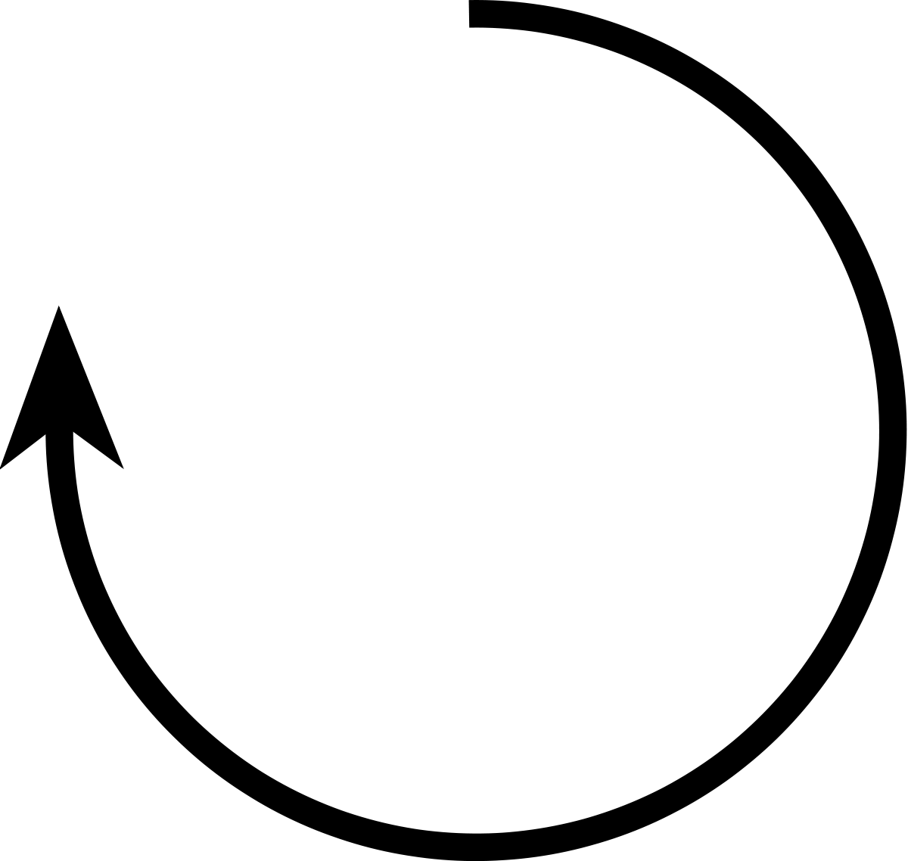
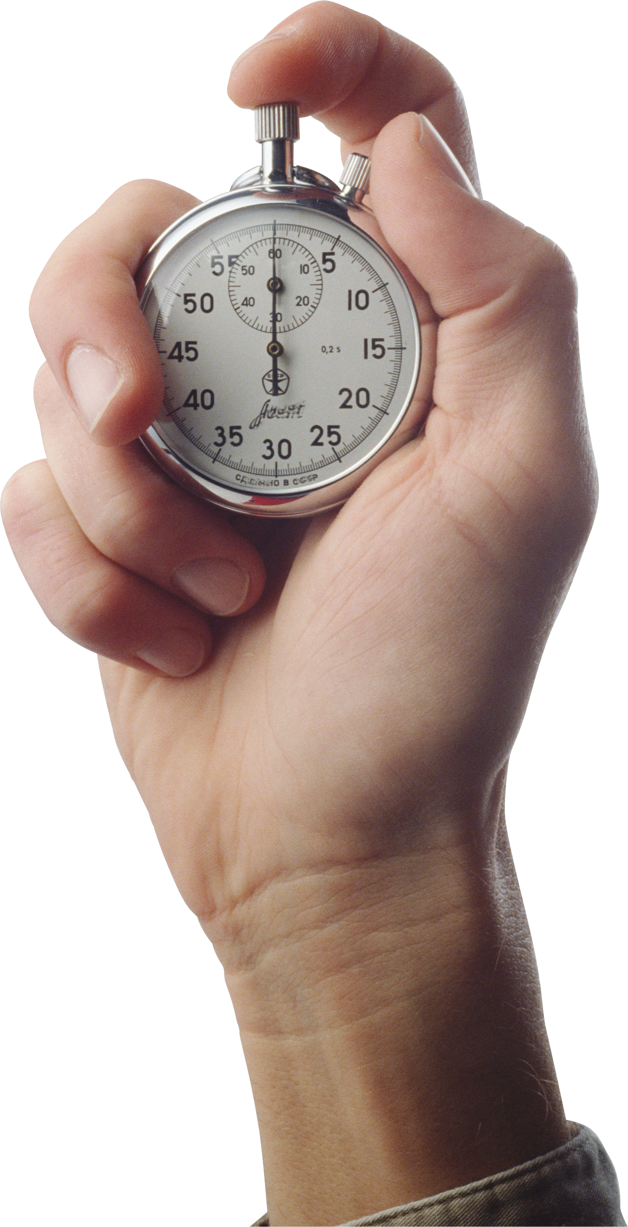
Verification Plan
Pressure Sensing
Externally time that the flow valve is closed every minute
Edwards (2020)
This Photo by Unknown Author is licensed under CC BY-SA
Notes:
Verification:
-Vary the height difference between the two bags and manually calculate the pressure with p=(rho)(g)(h). Should be the same reading as the transducer.
-can also verify that the LED screen is outputting the correct pressure.
-probably want to disable drainage bag uppy-downy response
-Controlling: Verify that our device also correctly controls the flow rate by manually calculating the flow rate from the outputted pressure.
-External Stopwatch to ensure correct sampling rate
-

Slide 8
Verification Plan
Pressure/Fluid Controlling
Disrupt ICP from baseline & observe restoration back to normal pressure
Drainage Bag (Mobile)
Pressure Imbalance
Pressure Restored to Baseline
Drainage Bag (Mobile)
Drainage Bag (Mobile)

Slide 9
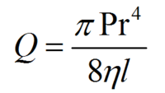
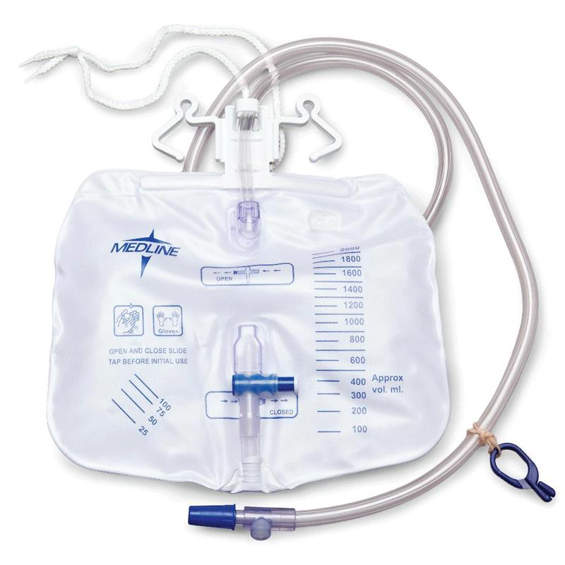
Verification Plan
Pressure/Fluid Controlling
Compare calculated fluid volume to fluid volume obtained
Medline (2020)
Notes:
Verification:
-Vary the height difference between the two bags and manually calculate the pressure with p=(rho)(g)(h). Should be the same reading as the transducer.
-can also verify that the LED screen is outputting the correct pressure.
-Verify that our device also correctly controls the flow rate by calculating the flow rate and comparing to the fluid received.
-External Stopwatch to ensure correct sampling rate
-

Slide 10
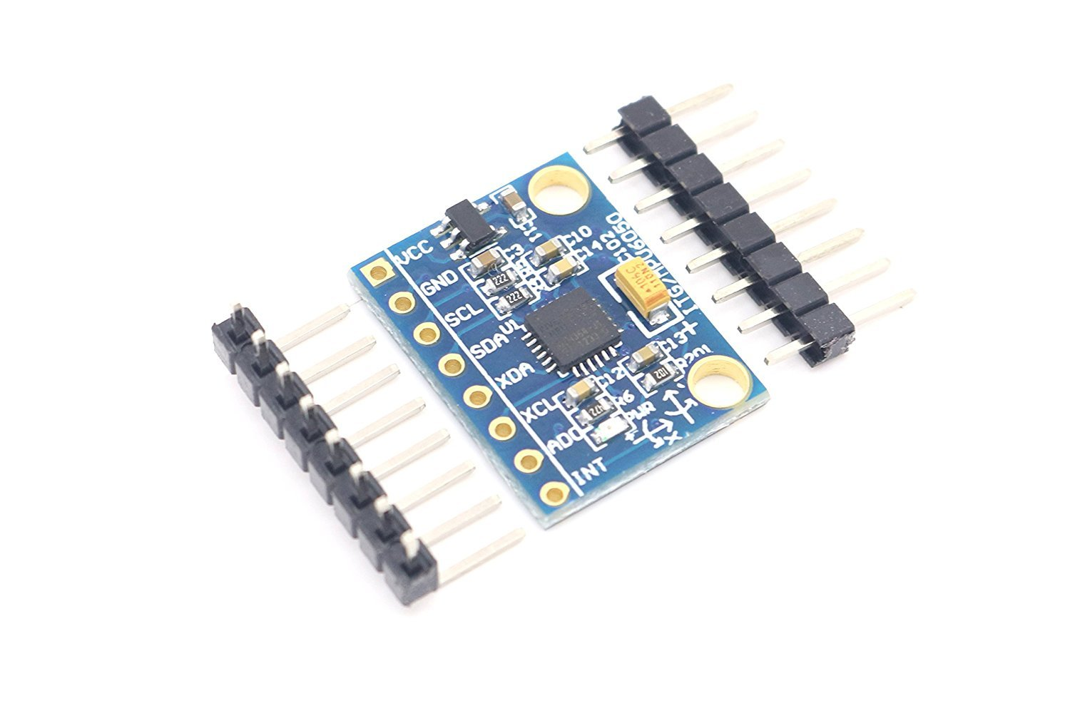
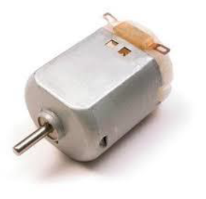
Verification Plan
Pressure/Fluid Controlling
Jerk accelerometer/gyroscope and observe a stop in fluid flow
Edwards (2020)
Notes:
Remember to talk about size and cost after this

Slide 11
Validation Plan
Autonomous Pressure Control
Disrupt ICP from baseline & observe restoration back to normal pressure
Drainage Bag (Mobile)
Pressure Imbalance
Pressure Restored to Baseline
Drainage Bag (Mobile)
Drainage Bag (Mobile)

Slide 12
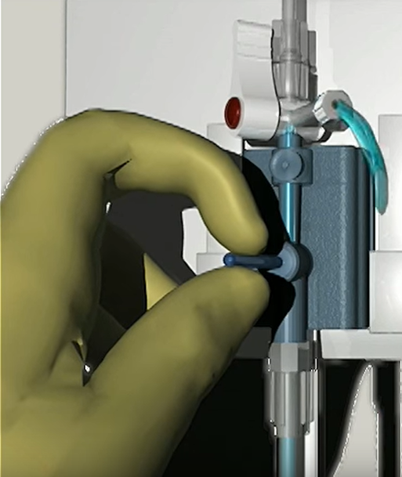
Validation Plan
Calibration
The device should only need to calibrated once
Osborn, B. (2014)
Truwave (2015)

Slide 13
Validation Plan
Low Cost
The device should save the hospital money long-term
Expense | Cost
Arduino Motors | $30
Pulley System | $10
Accelerometer/Gyroscope | $10
Software | $5
Time in Hospital | $250
Total | $305
Expense | Cost
ICU Stay | $1500
Anaseth, C. ICU and non-ICU cost per day. (1995)

Slide 14
The automated EVD falls under an FDA Class II medical device
Class II Device
Not Implanted
Substantially Equivalent
Moderate Risk of Harm
Notes:
Class II devices require adequate testing and performance standards which we hope to have accomplished through verification
We then need to continue to refine the prototype in the lab, making the situation as close to clinical as possible

Slide 15
A 510(k) can be filled out since the device utilizes current drainage methods
Substantial Equivalence
Same Intended Use
Same Technological Characteristics

Slide 16
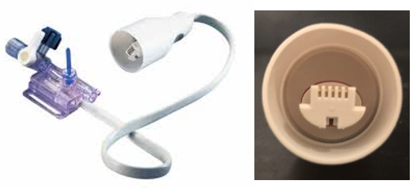
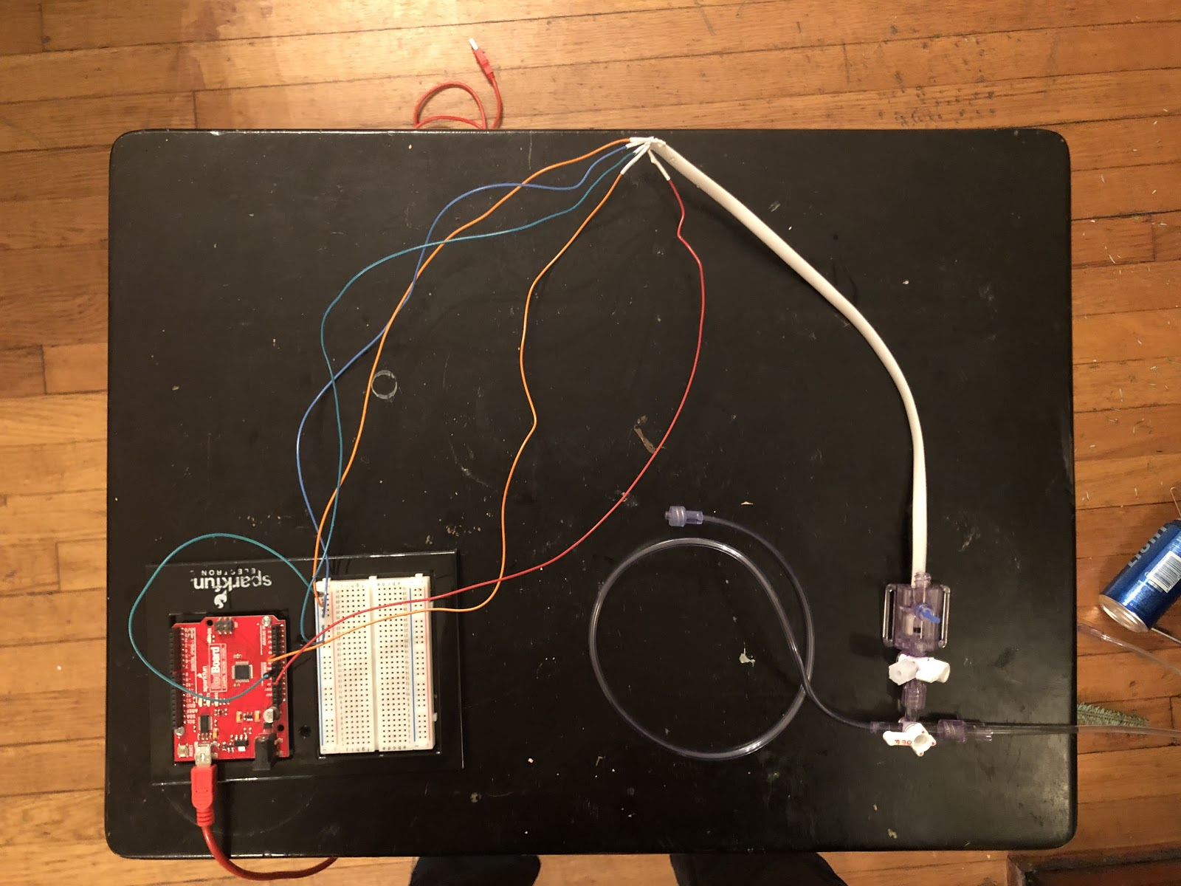
Proof-of-concept: successfully achieving a pressure-sensor/Arduino interface
Pressure Sensor-Arduino Interface
Edwards (2020)
Drainage Bag
Arduino
US 7,604,602 B2

Slide 17
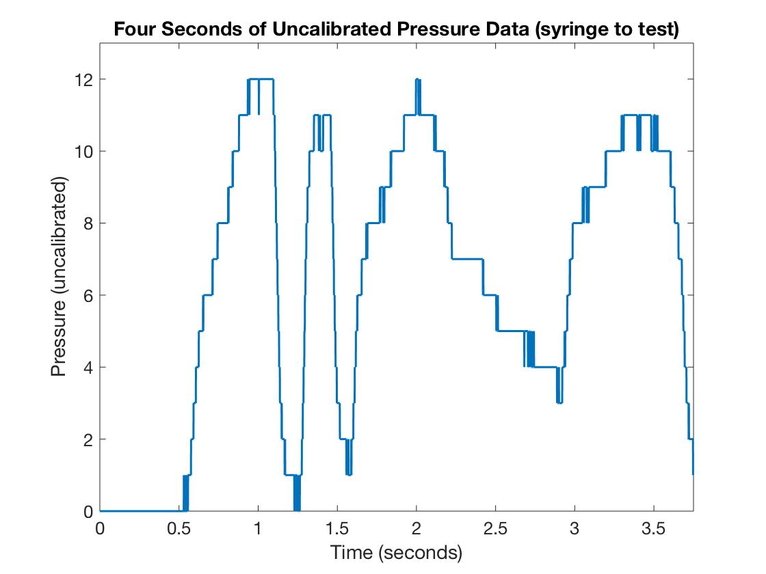
Pressure-sensor/Arduino interface was successfully achieved
Water Injected

